Slide 1
Trash Mapping
Sophia Militello

Slide 2
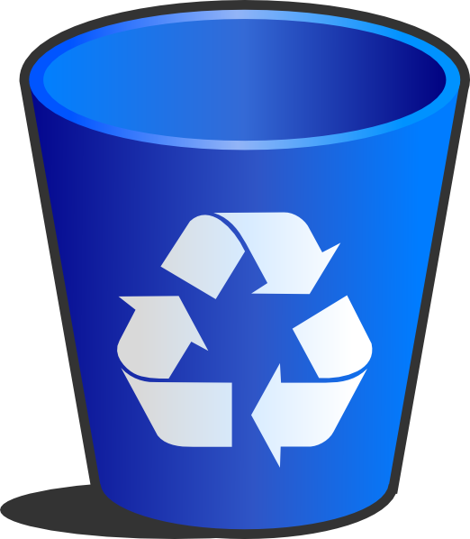
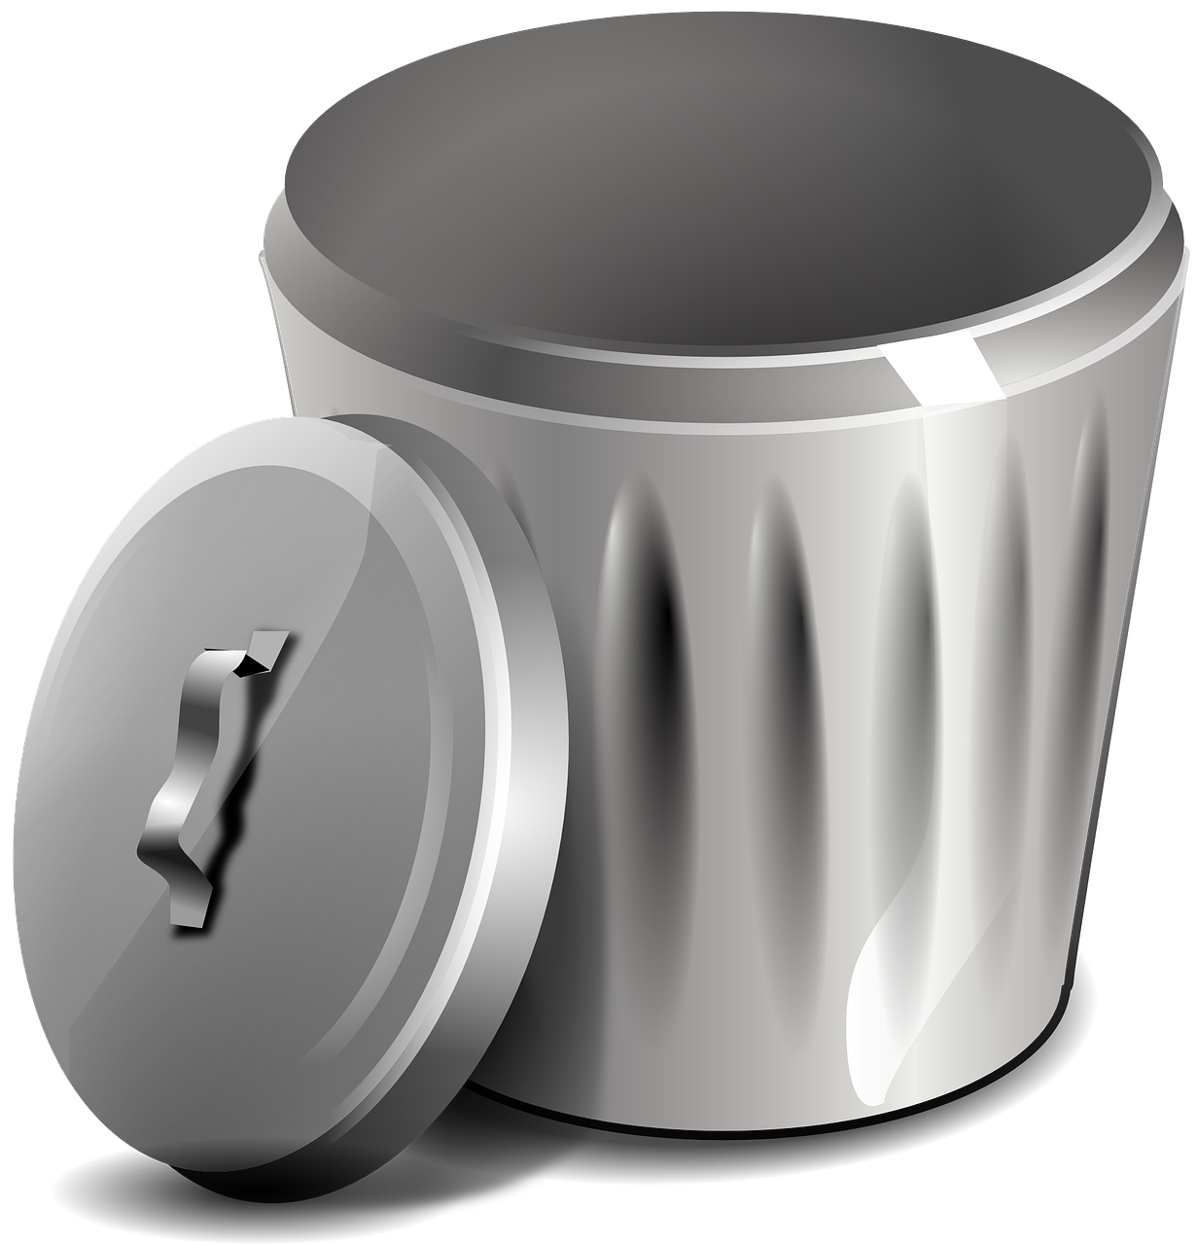
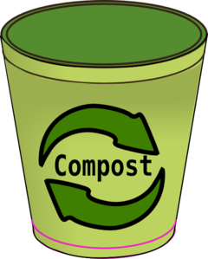
What is the most sustainable pathway our waste can take?

Slide 3
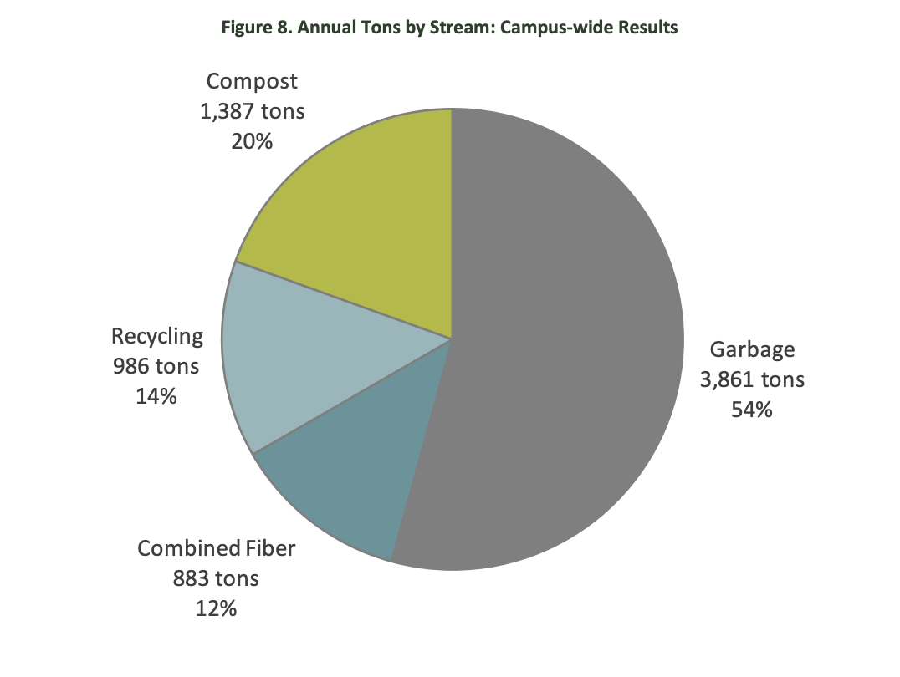
University of Washington Waste Characterization Study 2018

Slide 4
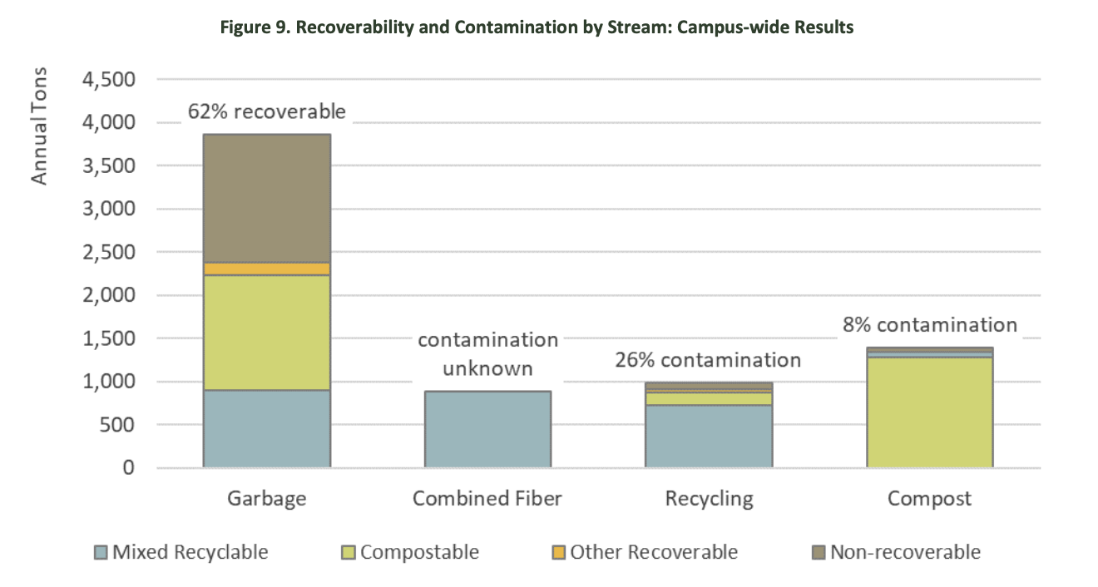

Slide 5
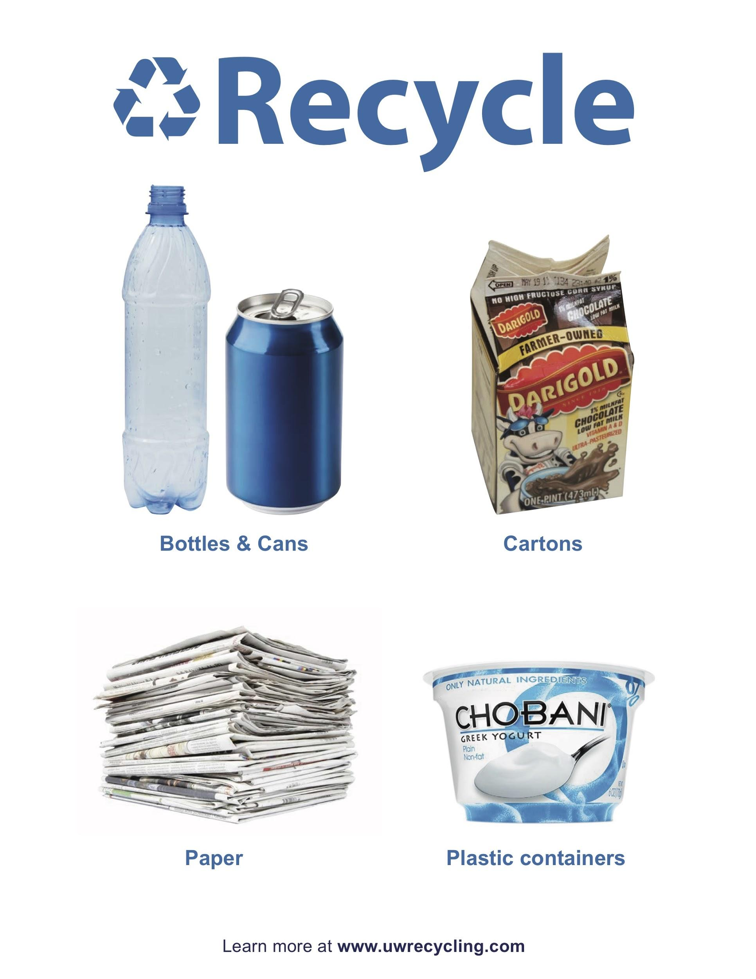
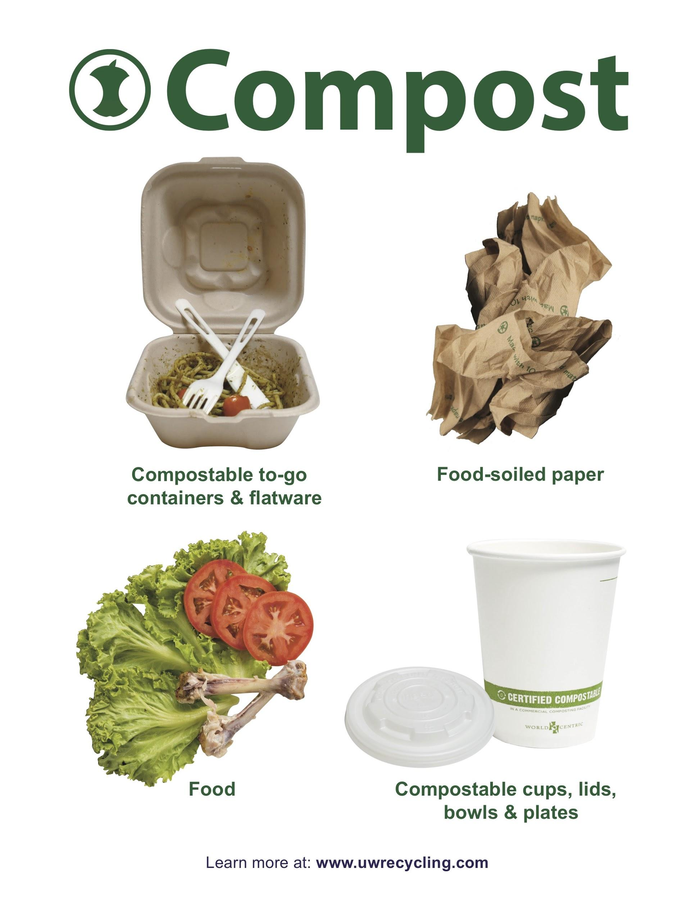
Research
Difficulties
Interaction locally with waste
Life cycles
Signage
Lack of transparency
Recycling contamination
China

Slide 6
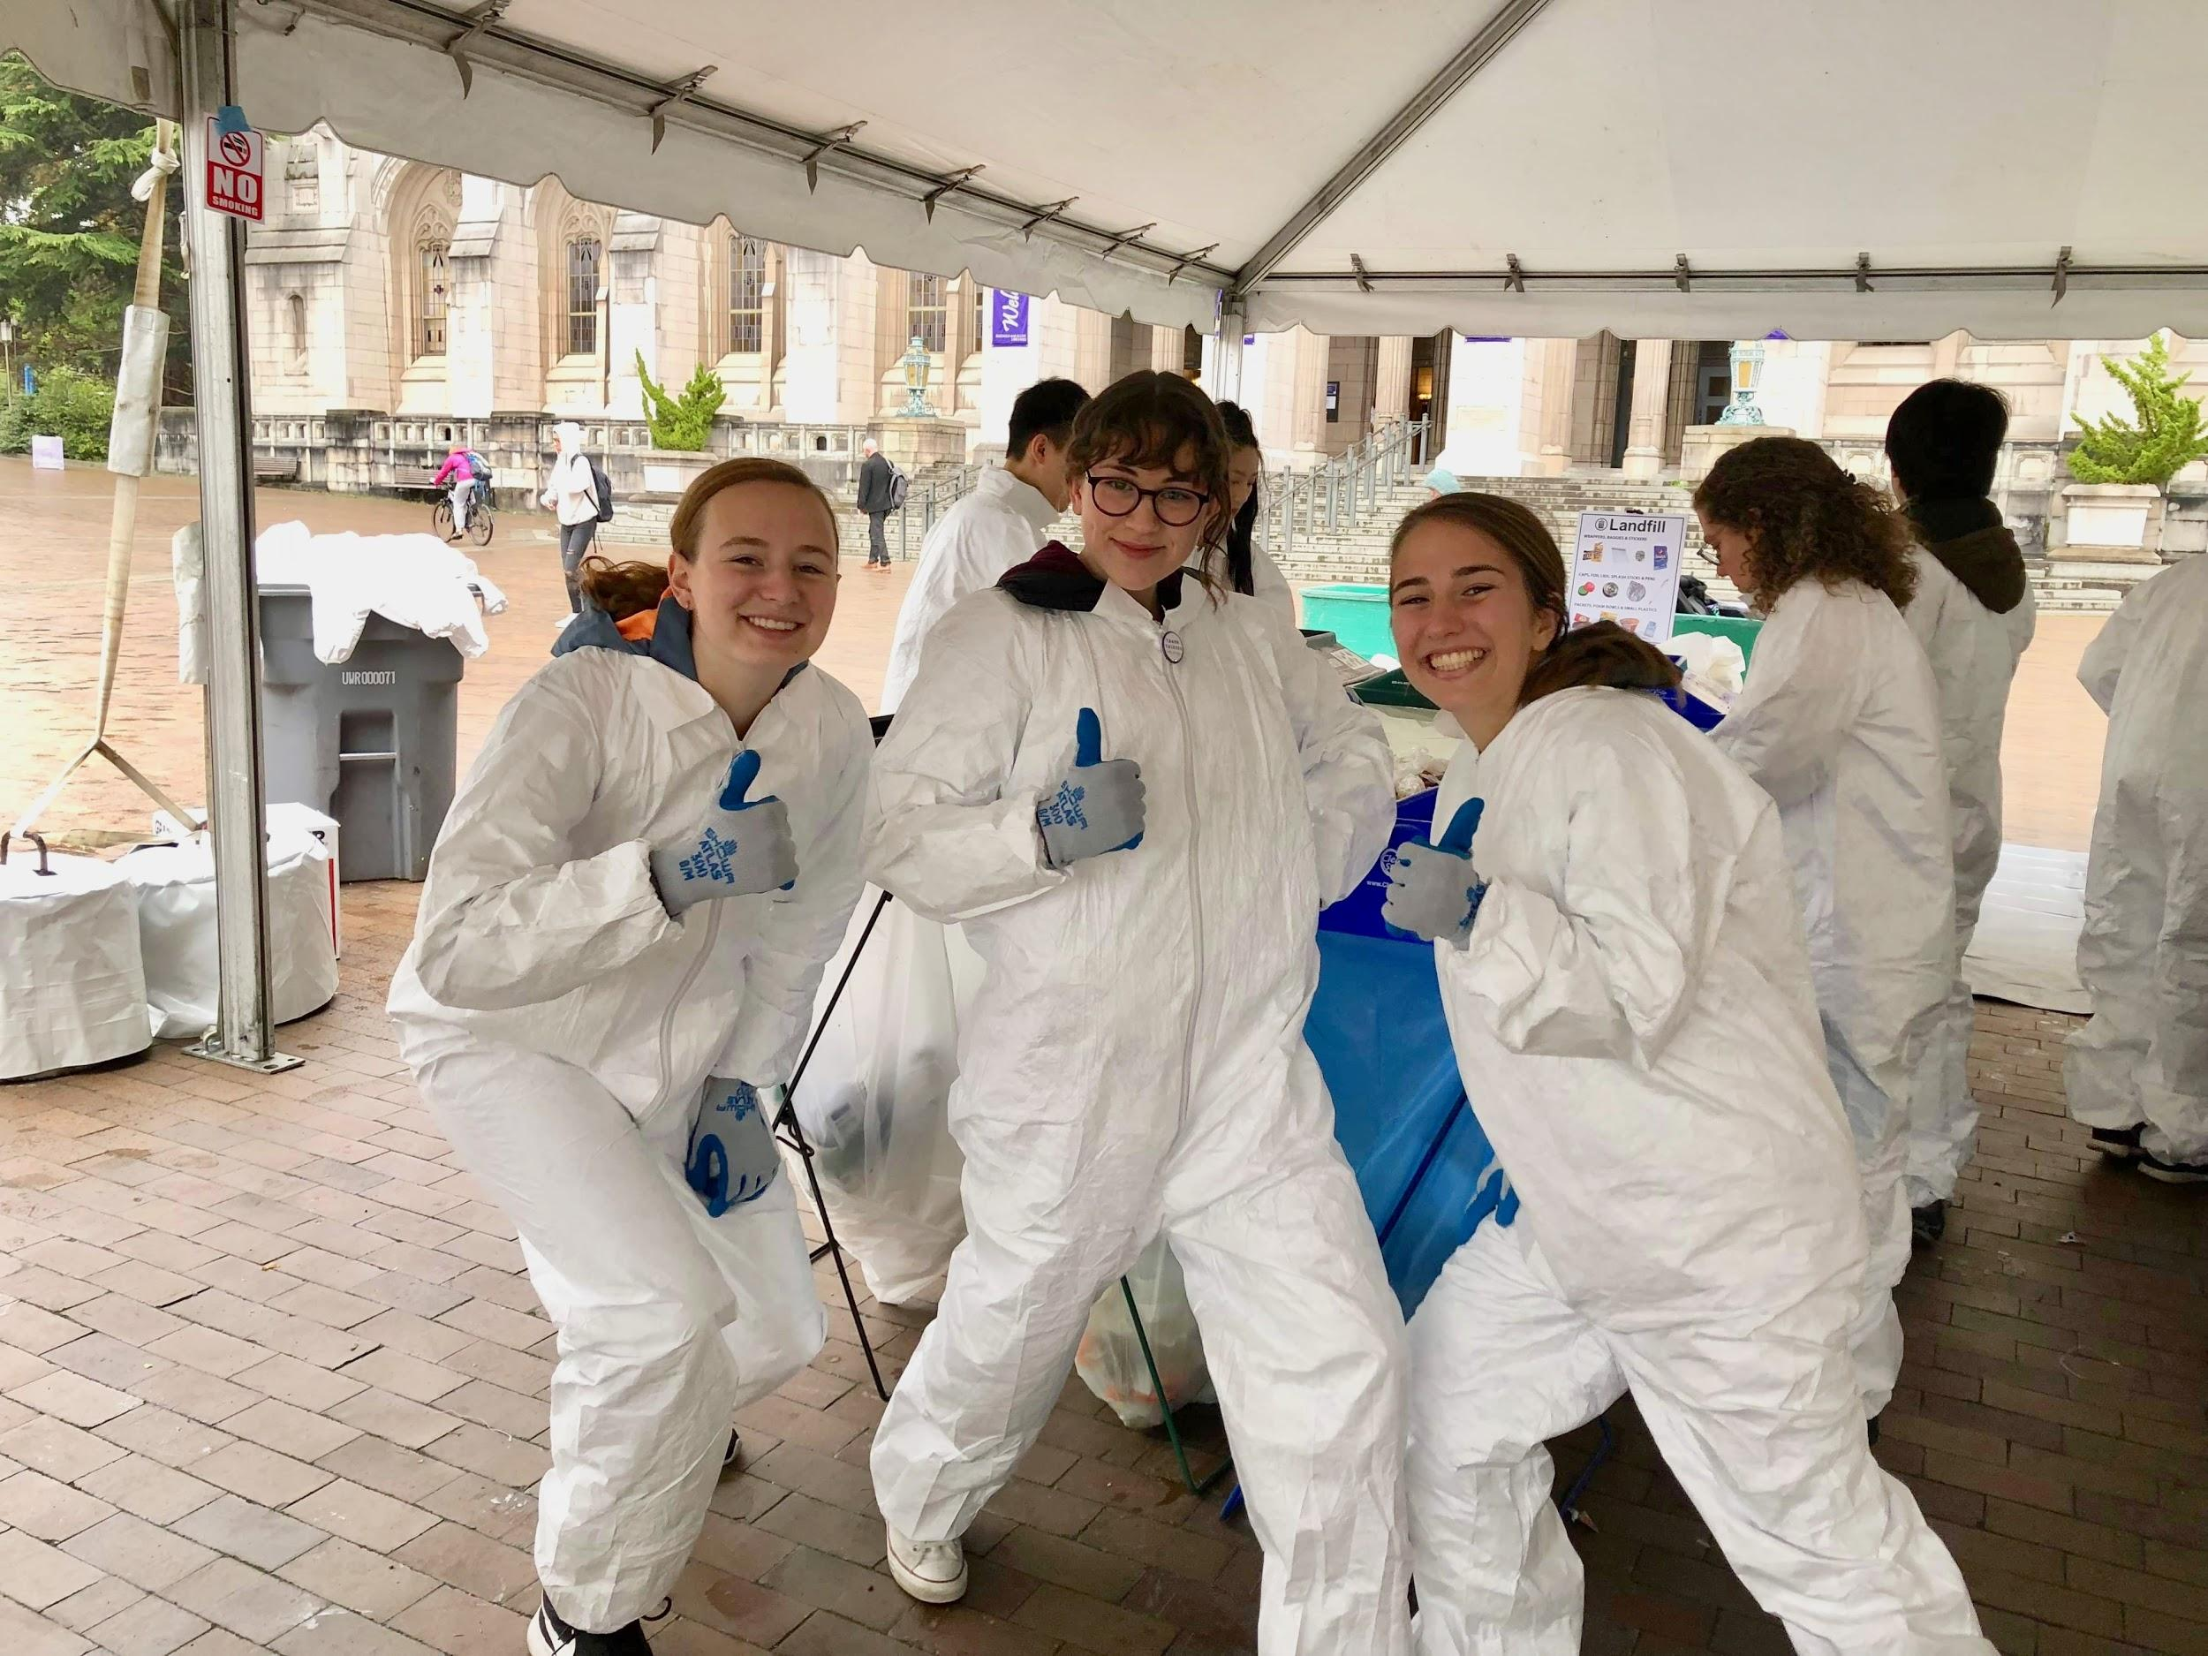
I Have Learned
Trash-in opportunity
Cannot recover recycling - highest contamination
Why not compost?
Best to not use any bin - REDUCE CONSUMPTION
Notes:
Recycling isn’t that great
Dont want to discourage recycling
My poster would not do well above garbage cans
Relation to simple signage

Slide 7
Research
Design
Digitize
Feedback
Seattle and UW process
Signage
Choosing piece of waste
Drawing on paper
Learn InDesign and Illustrator
Drawing → Digital
Receive critiques
Rework

Slide 8
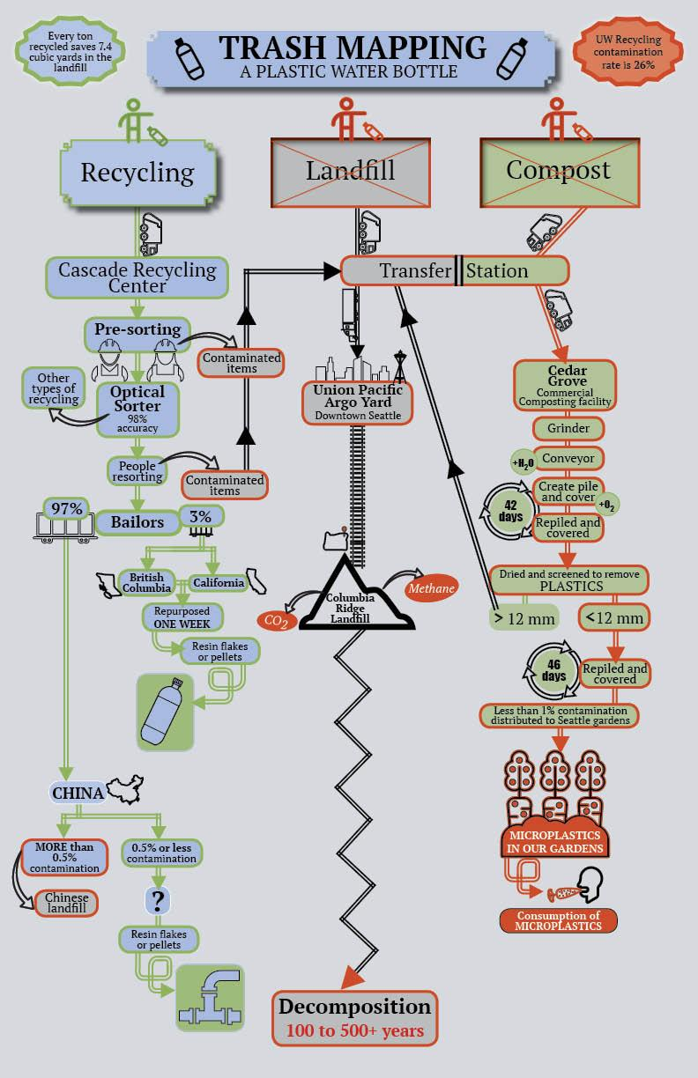
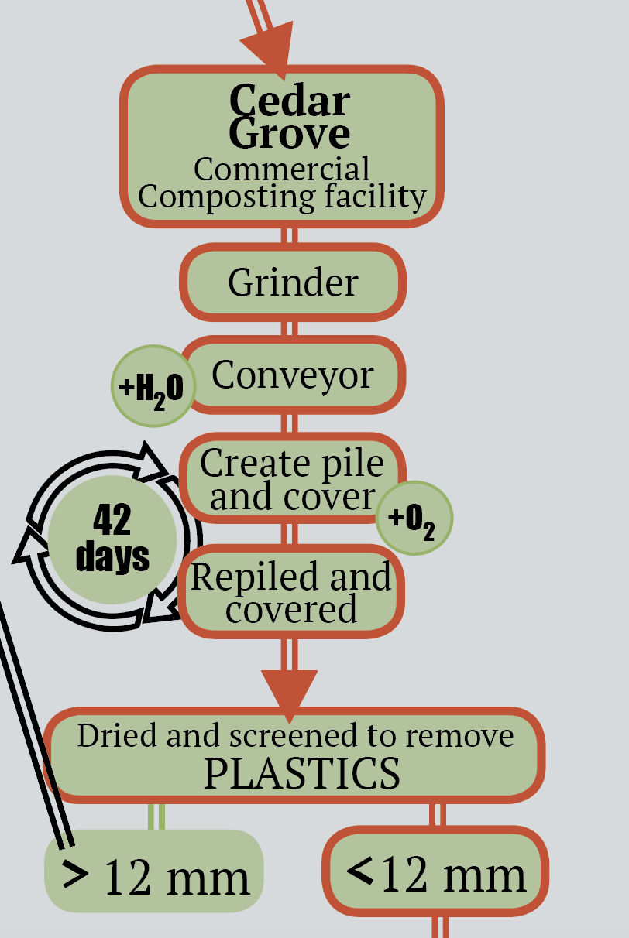
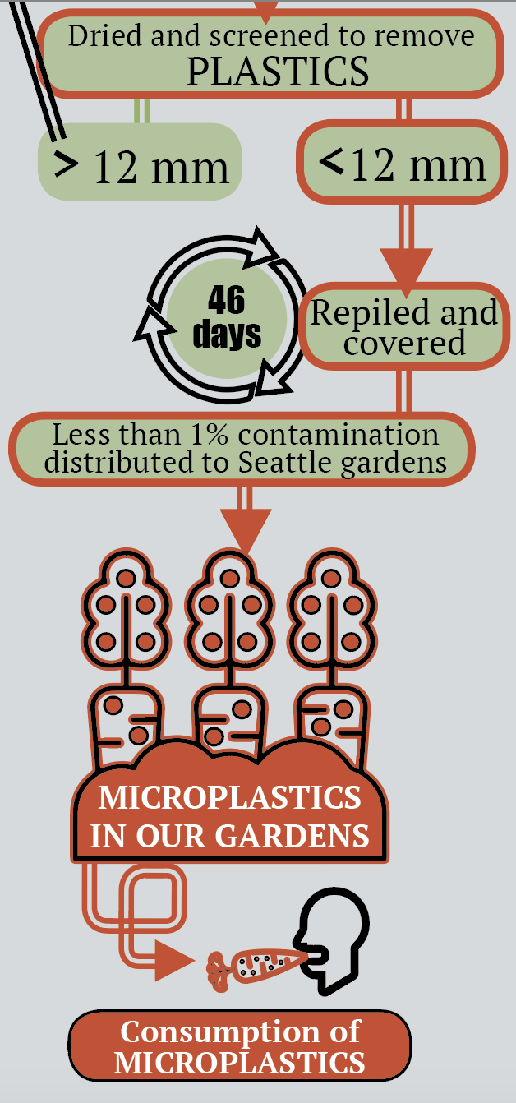
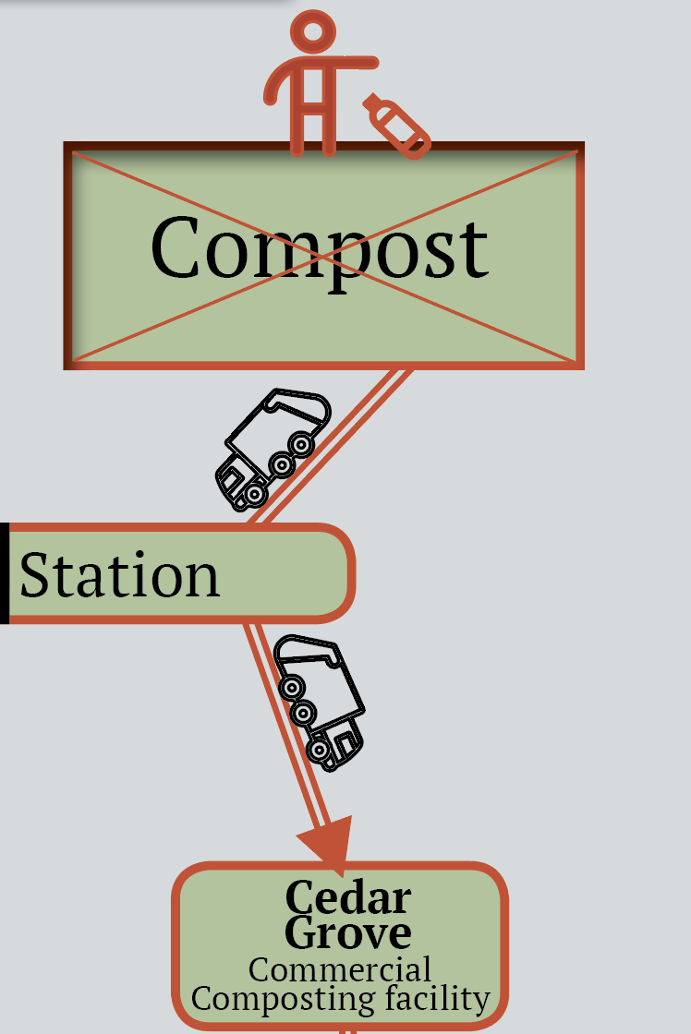
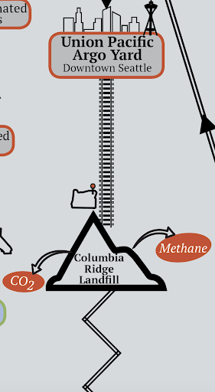
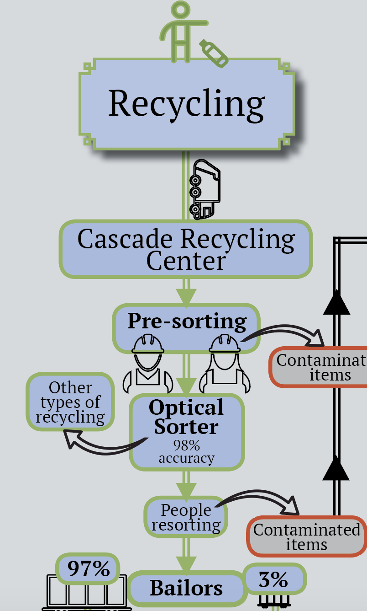
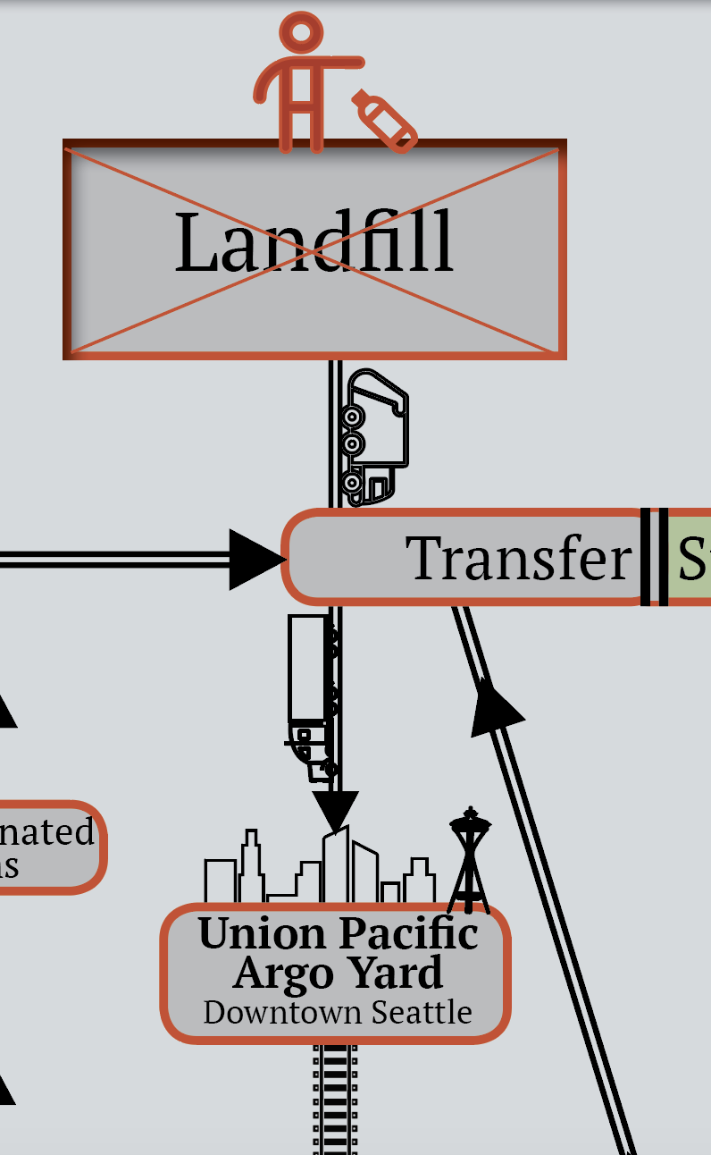
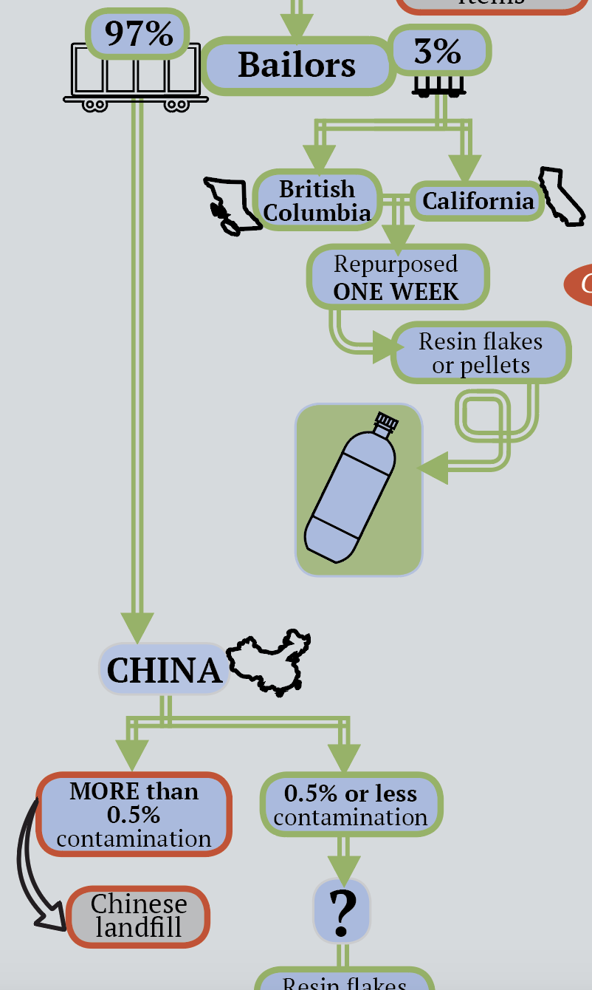
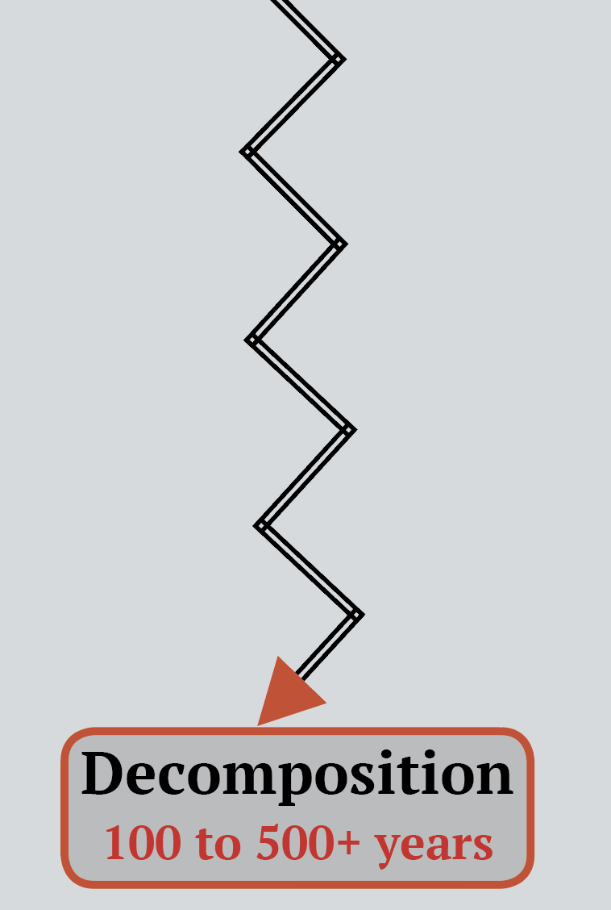
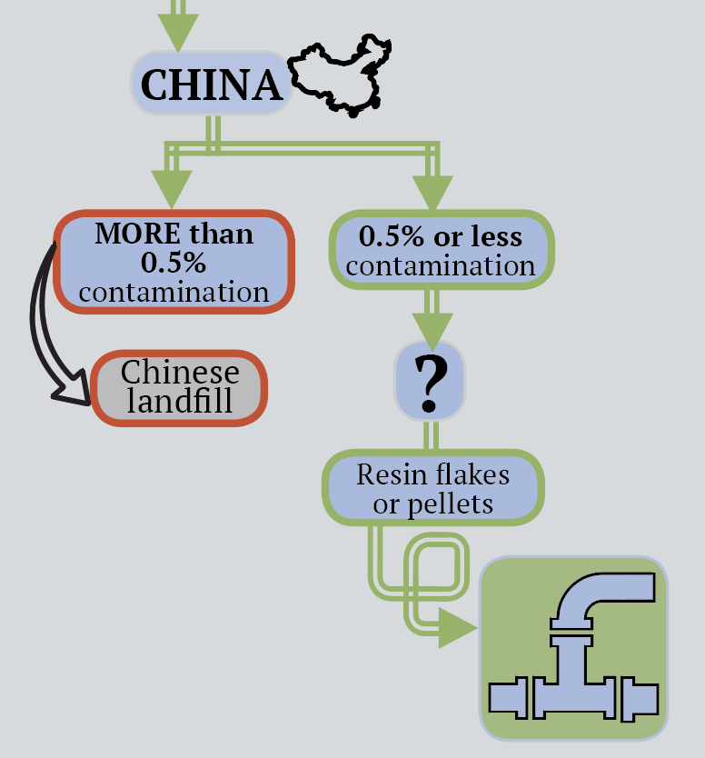

Slide 9
These posters can...
Promote intentionality
Increase waste diversion
Improve the efficiencies of cycles

Slide 10
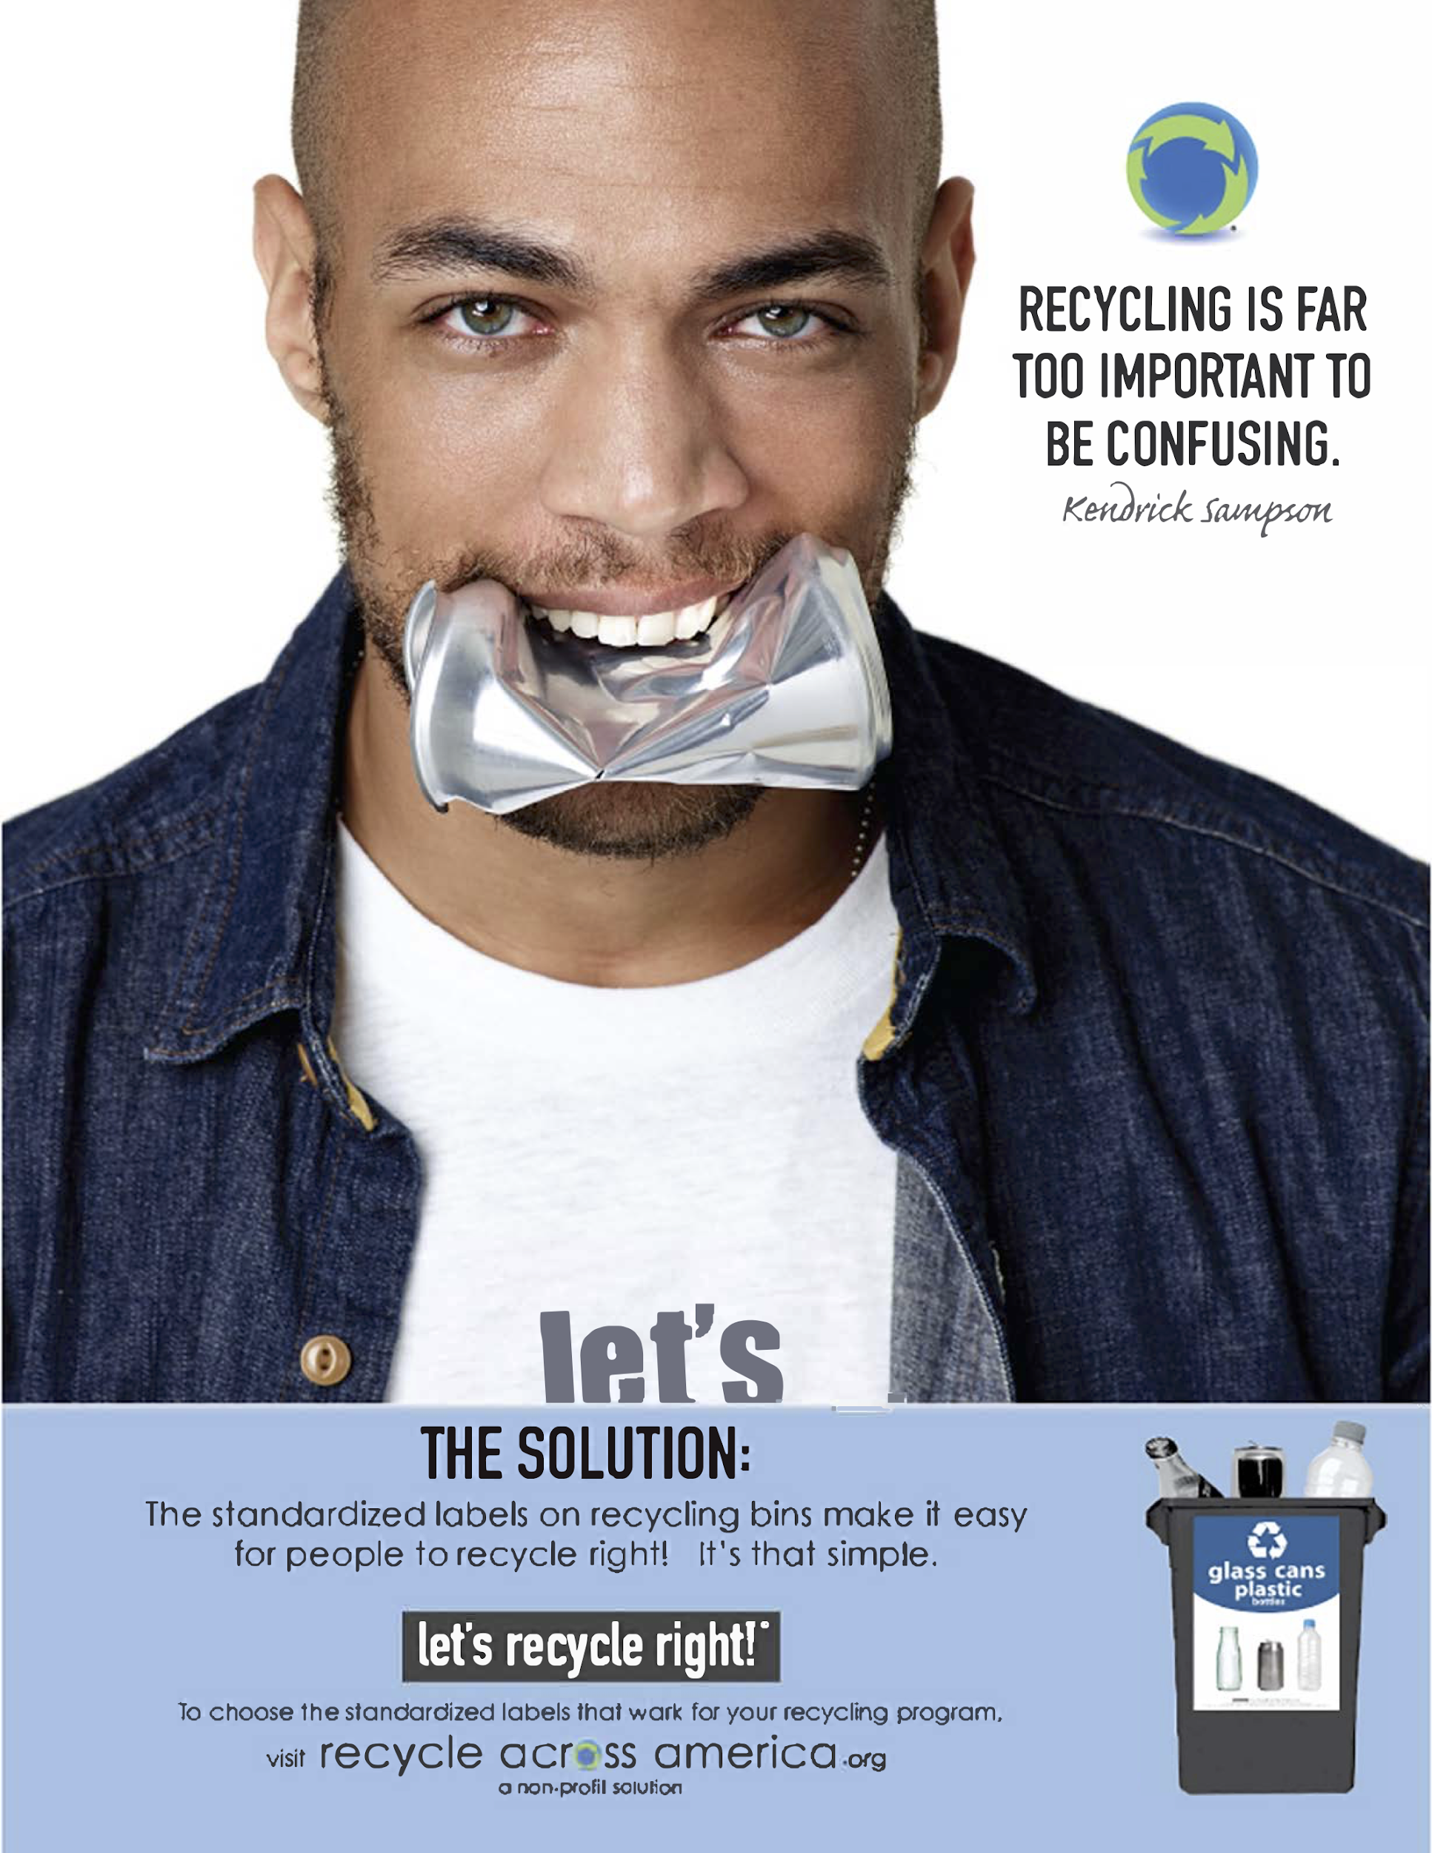
Next Steps
Pathway of other pieces of waste
Tea bag
Plastic wrap
Compostable plastic
Establish the future of my posters
Extend signage research

Slide 11
Acknowledgements
Megan Herzog & Nico Martinucci
Christopher Campbell
Hannah Johnson - Mentor
Oskar Abian & Jasmine Leung

